Slide 1

Customer Shopping Behavior Analysis
This project analyzes transactional data from 3,900 purchases to uncover spending patterns, customer segments, and product preferences. By leveraging Python, SQL, and Power BI, we transform raw data into strategic business insights.

Slide 2
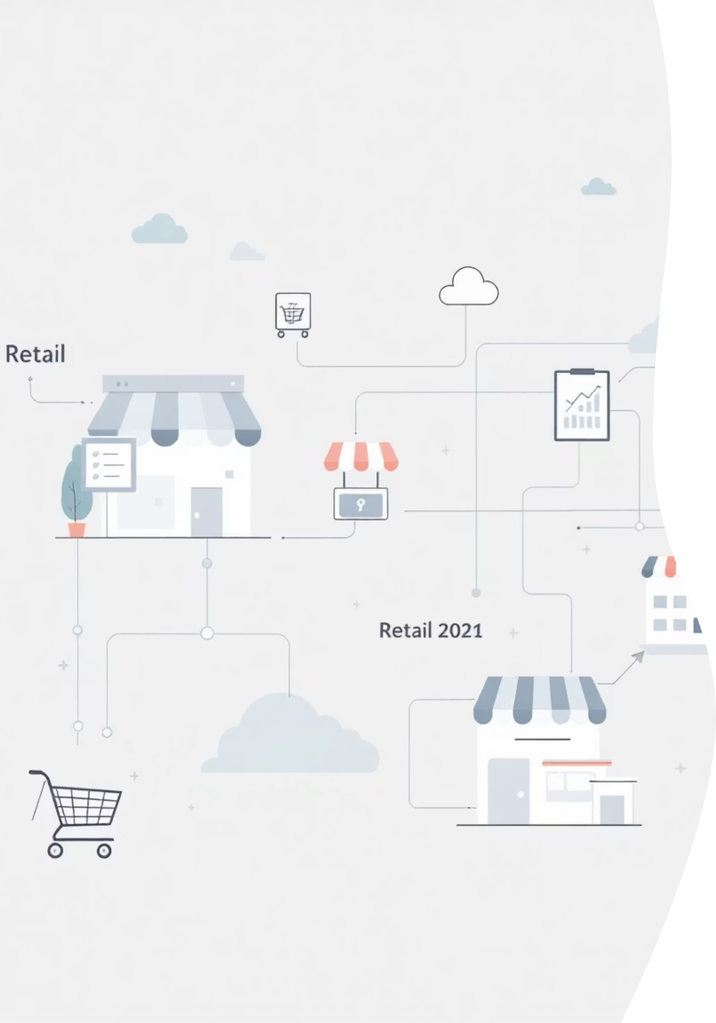
Dataset Summary & Key Features
Data Volume
Core Attributes
Total Rows: 3,900
Demographics: Age, Gender, Location
Total Columns: 18
Missing Data: 37 values in Review Rating
Purchase: Item, Category, Amount, Season
Behavior: Frequency, Rating, Shipping Type

Slide 3

Data Preparation in Python
We utilized Pandas for cleaning and feature engineering to ensure data consistency before analysis.
Cleaning & Imputation
Feature Engineering
SQL Integration
Handled 37 missing Review Ratings using the median rating per product category.
Created age_group bins and purchase_frequency_days for deeper segmentation.
Standardized columns to snake_case and loaded the DataFrame into MS SQL Server.

Slide 4
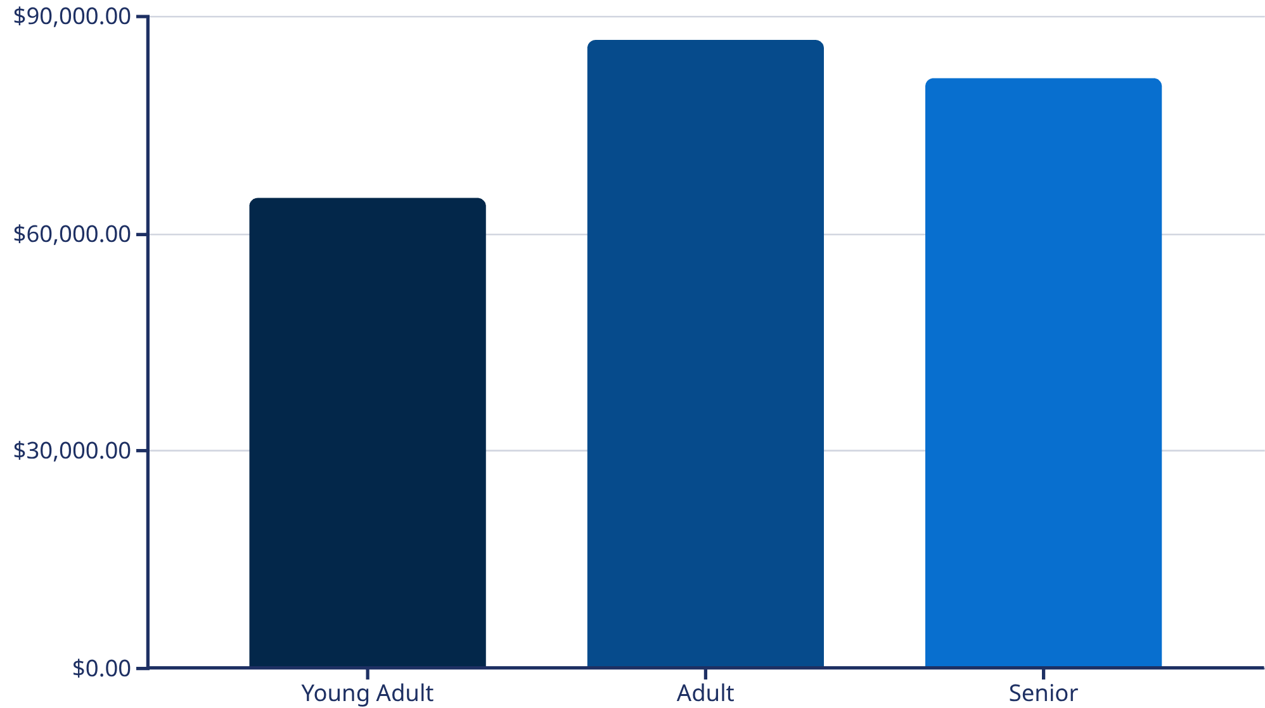

Revenue Analysis by Demographics
Analysis of total revenue contribution across Gender and Age Groups.
Gender Revenue Split
Male: $157,890
Female: $75,191
Male customers contribute significantly higher total revenue compared to female customers in this dataset.

Slide 5

Subscription & Shipping Impact
Comparing spending habits between subscribers and shipping preferences.
$60.19
$59.68
Avg Spend: Express
Avg Spend: Subscriber
Express shipping users spend slightly more than standard users ($59.35).
Subscribers maintain a consistent average purchase amount.
1053
Total Subscribers
Subscribers generated $62,845 in total revenue.

Slide 6
Top Rated Products
Identification of the top 5 products based on average customer review ratings.
Product Name
Avg Rating
Gloves
3.86%
Sandals
3.84%
Boots
3.82%
Hat
3.8%
Skirt
3.78%

Slide 7
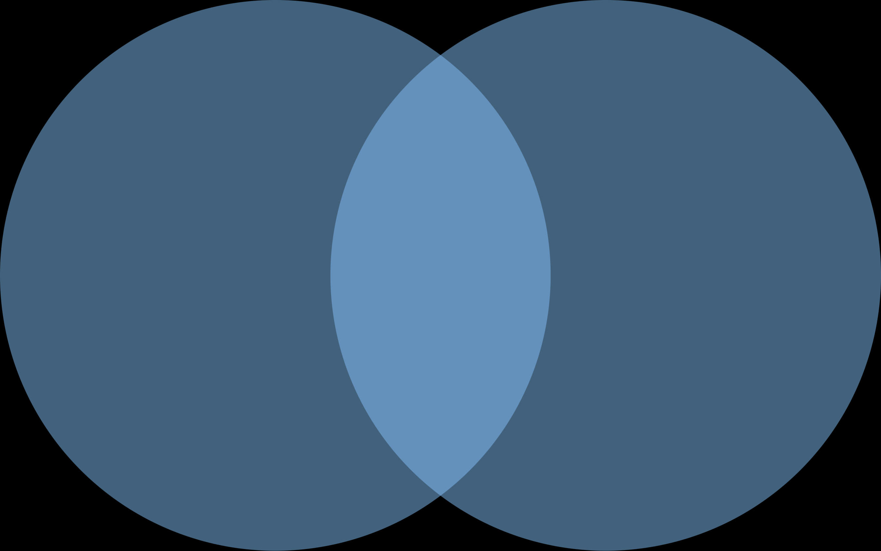
Discount Dependency & High Spenders
Analyzing the relationship between discounts and purchase volume.
Discount-Dependent Products
High-Spending Discount Users
Products with highest discount usage: Blouse, Jewelry, Pants, Shirt, and Shorts.
Identified customers who utilize discounts but maintain spending above the $59.75 average.
Promo Users with High Transactions
Discount Users
High Spenders

Slide 8
Customer Segmentation Strategy
Classification of the 3,900 customers based on their purchase history and loyalty.
New
Returning
Loyal
Customers with only 1 previous purchase.
Customers with 2 to 5 previous purchases.
Customers with more than 5 previous purchases.
Data shows that customers with >5 purchases are significantly more likely to become active subscribers.

Slide 9
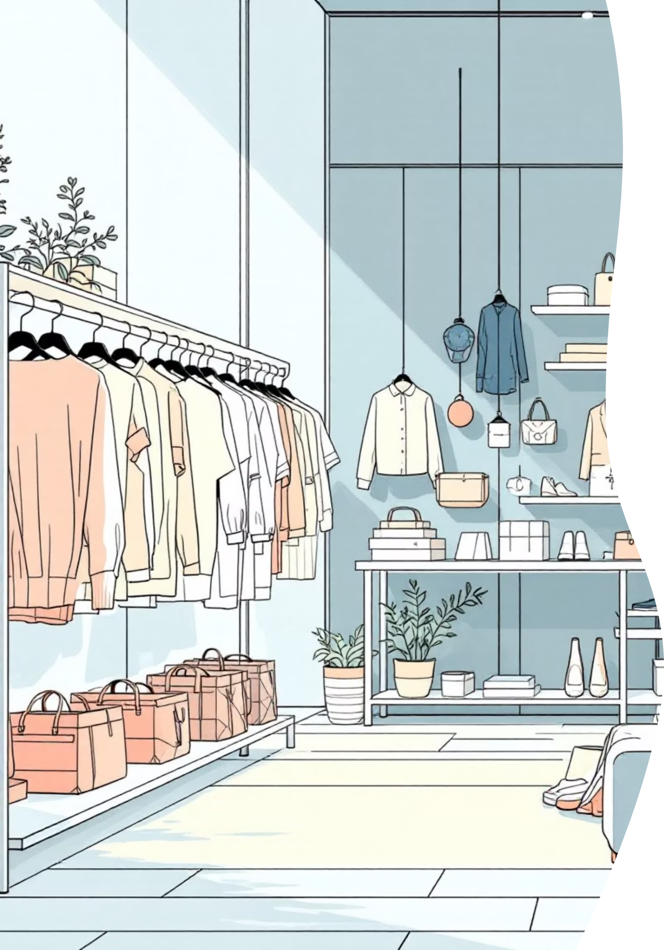
Category Performance
Top 3 most purchased products within each major retail category.
Clothing
Accessories
Footwear
Outwear
Pants
Jewelry
Sandals
Jacket
Shirt
Sunglasses
Shoes
Coat
Blouse
Belt
Sneakers

Slide 10

Strategic Recommendations
Boost Subscriptions
Optimize Discount Policy
Targeted Marketing
Target "Loyal" segment (>5 purchases) with exclusive benefits to convert them to subscribers.
Reduce discounts on high-rating items like Handbags; maintain them for "Discount-Dependent" items like Blouses.
Focus campaigns on the "Adult" age group (26-50) as they are the highest revenue contributors ($86,780).

